Slide 1

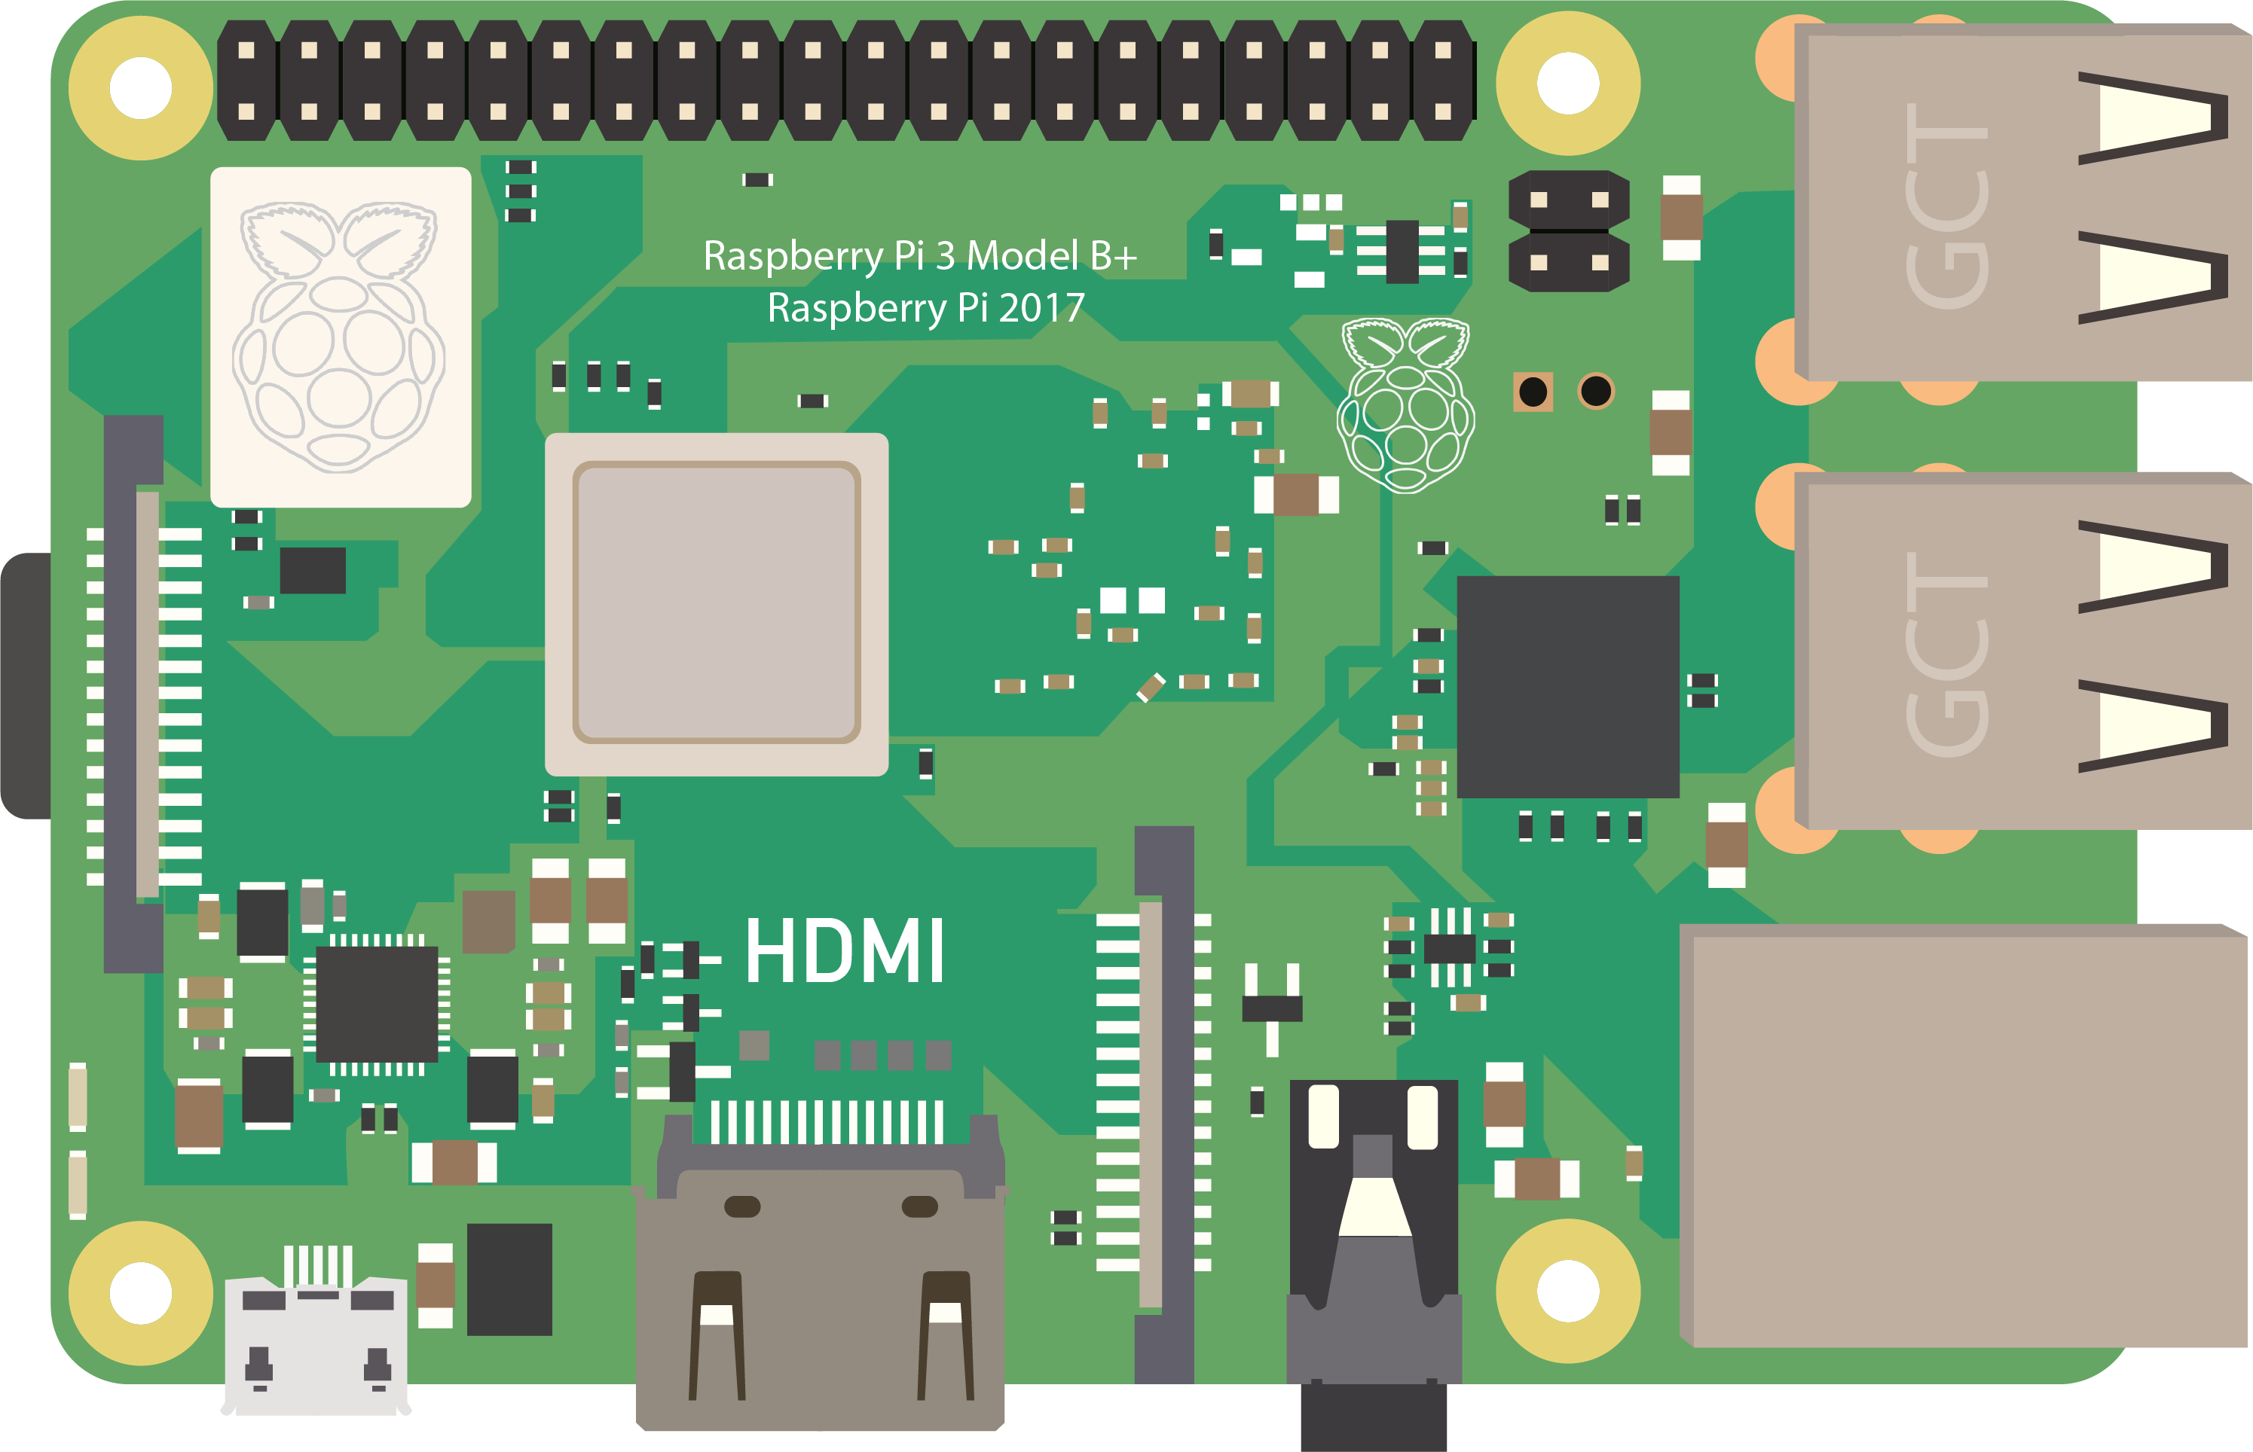
WEBINAR
Raspberry Pi Headless Setup
Setting up your raspberry pi without a Monitor and Keyboard & Mouse

Slide 2
Requirements
WEBINAR
Raspberry Pi
Power Adaptor
Sd Card
Laptop (Windows, Mac or Linux)
Raspberry Pi Imager Installed
Phone with Fing app installed (or any other network scan app)
Good Internet Connection

Slide 3
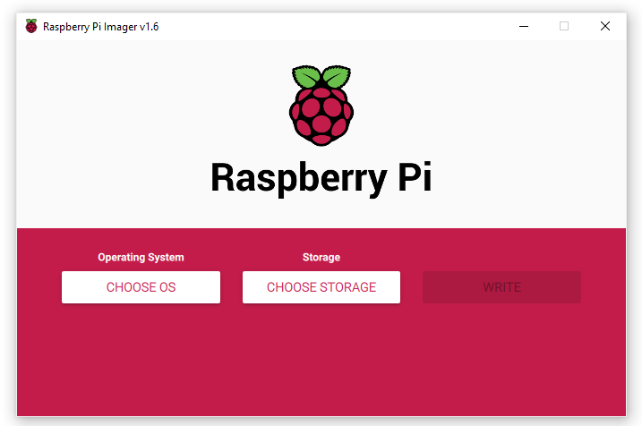
Step 1: Download and install Raspberry Pi Imager
WEBINAR
Download it at : https://www.raspberrypi.org/software/

Slide 4
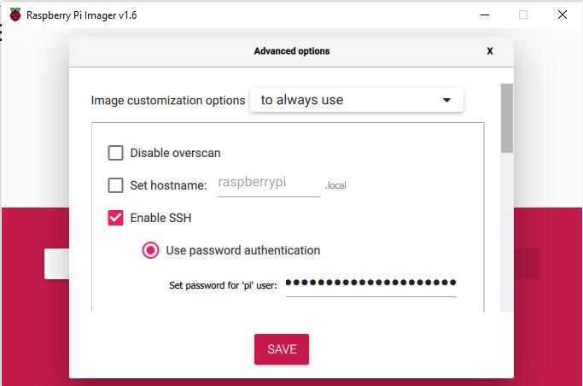
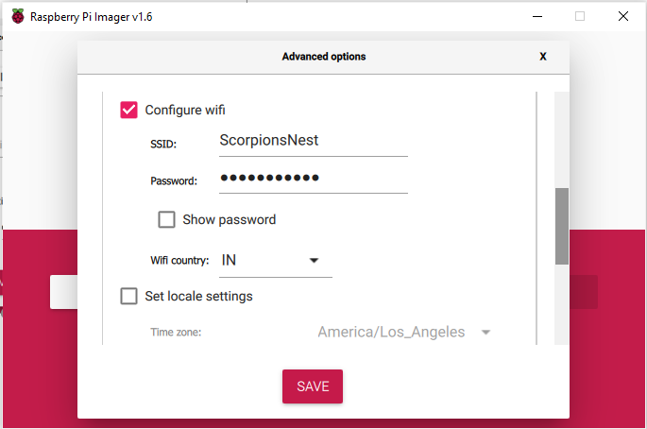
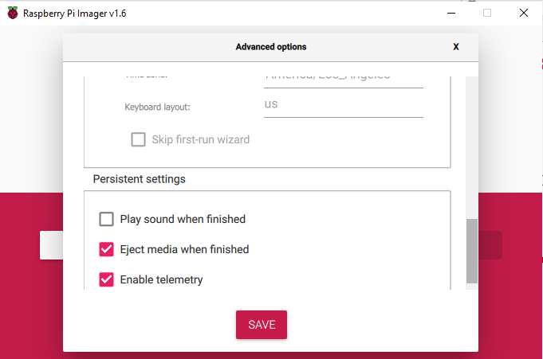
Step 2: Launch and Configure the OS
WEBINAR
Press : Cntrl + Shift + X to open hidden configurations

Slide 5
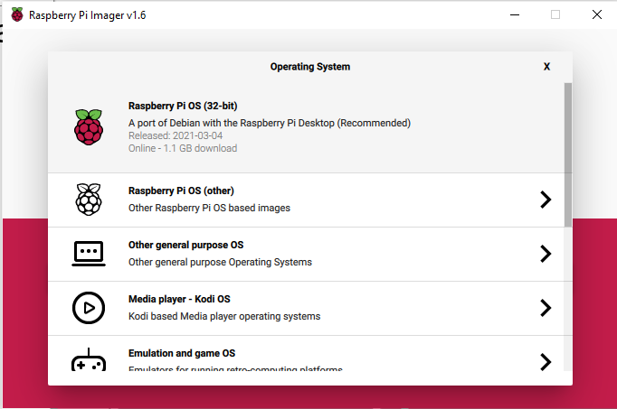
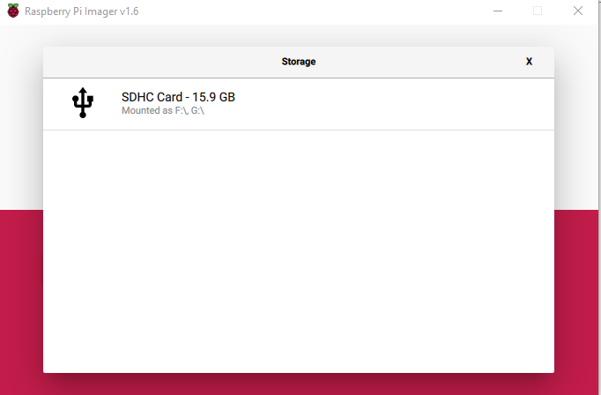
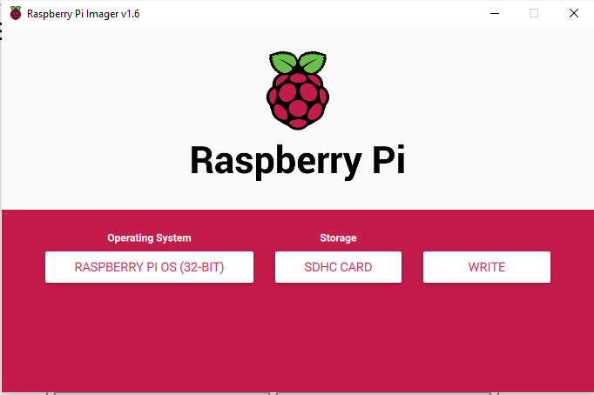
Step 3: Format and Install the OS
WEBINAR

Slide 6
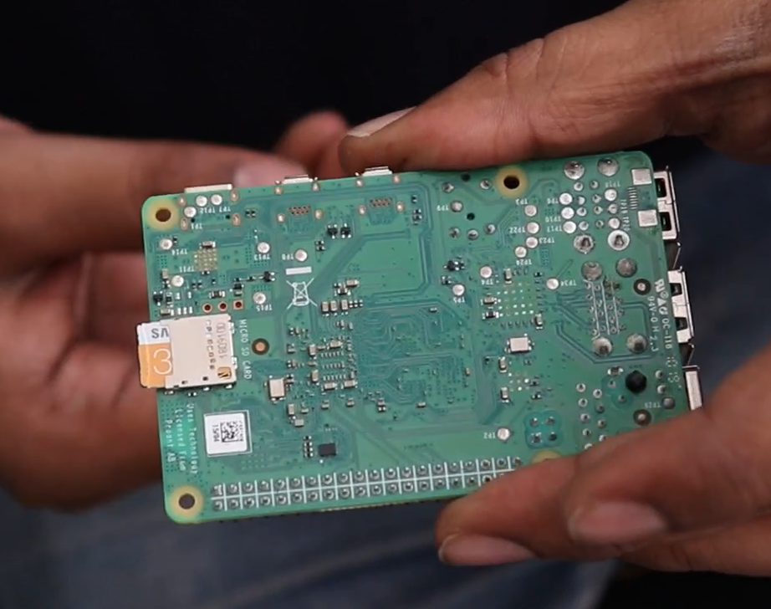
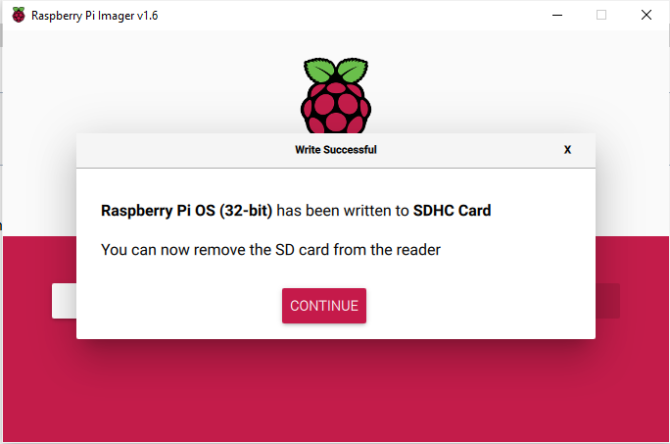
Step 4: Plug in the SD card and Power ON
WEBINAR

Slide 7
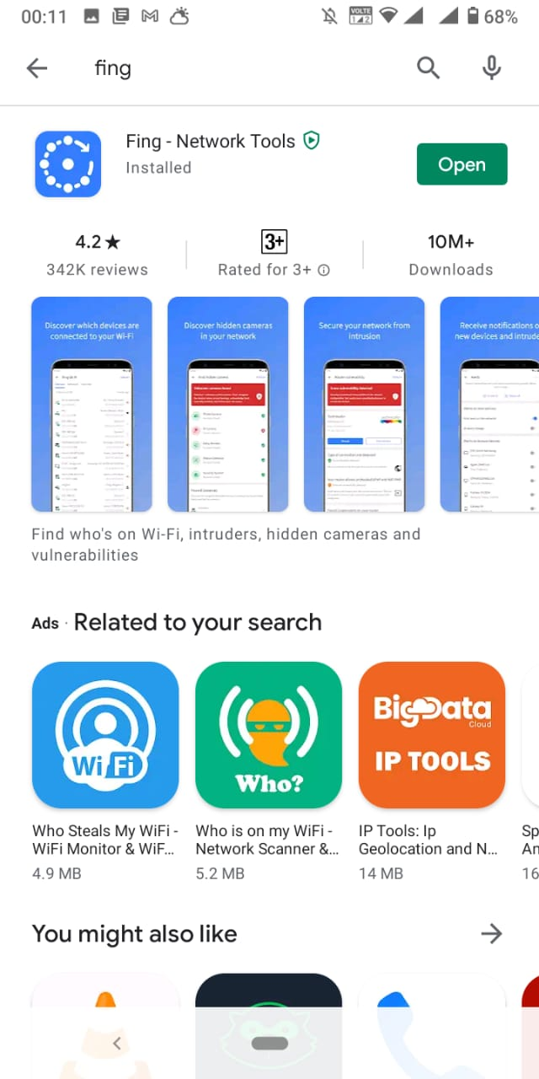
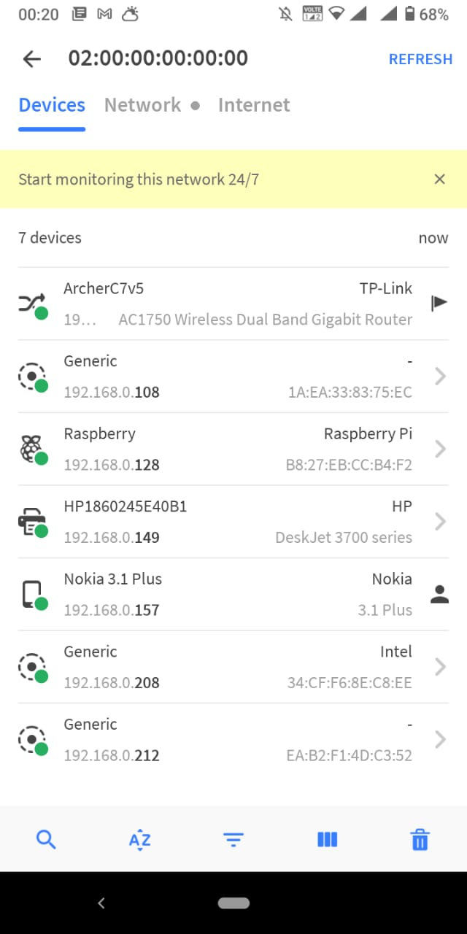
Step 5: Find the IP address of The pi with Fing
WEBINAR
On a mac : arp –a
*fing not required

Slide 8
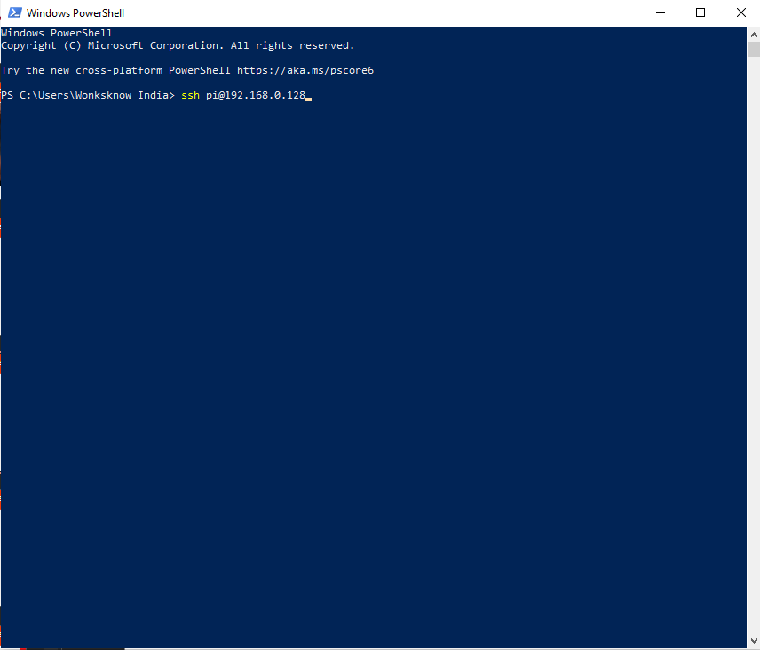
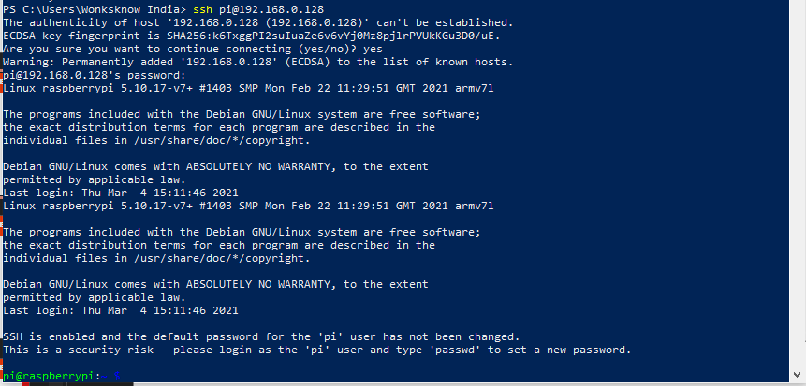
Step 6: SSH into the Pi from PowerShell
WEBINAR
Command : ssh hostname@ip Ex: ssh pi@192.168.0.128

Slide 9
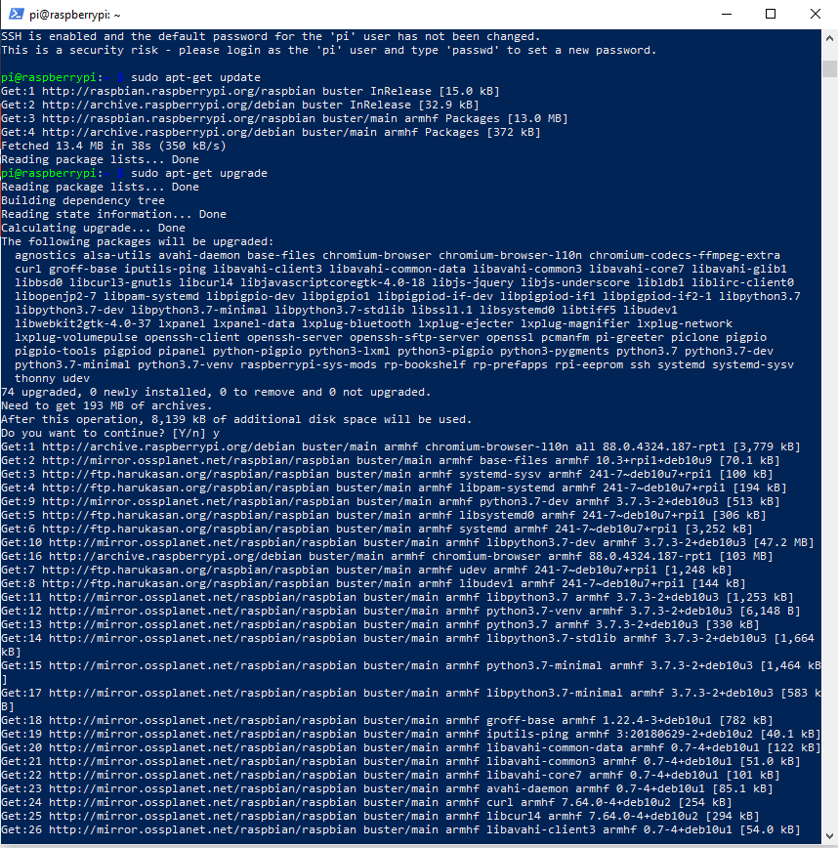
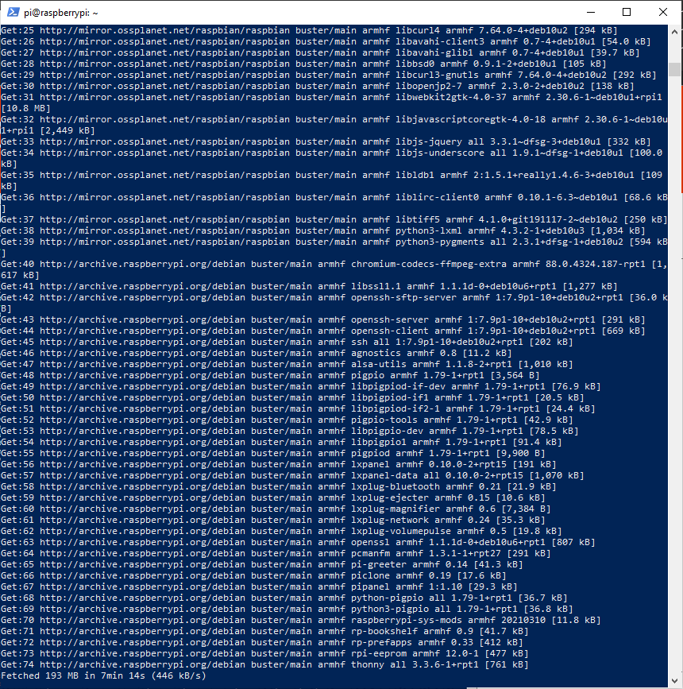
Step 7: Update the OS
WEBINAR
Command : sudo apt-get update
Command : sudo apt-get upgrade

Slide 10
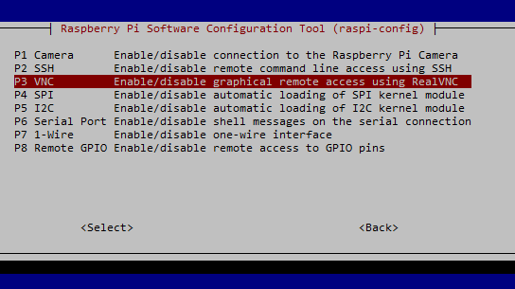
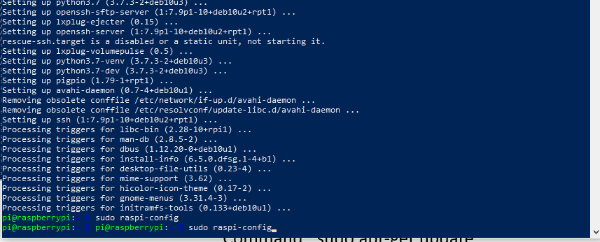
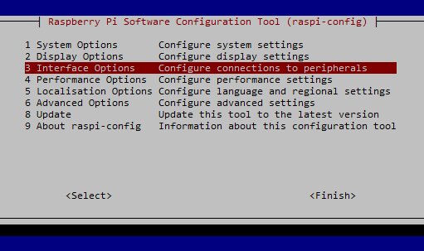
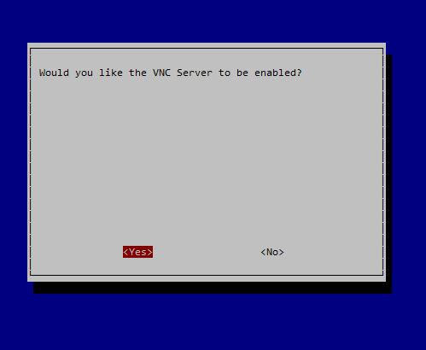
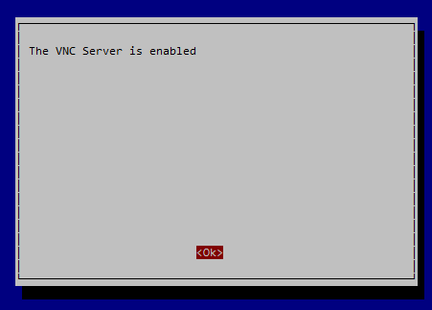
Step 8: Enable VNC
WEBINAR
Command : sudo raspi-config

Slide 11
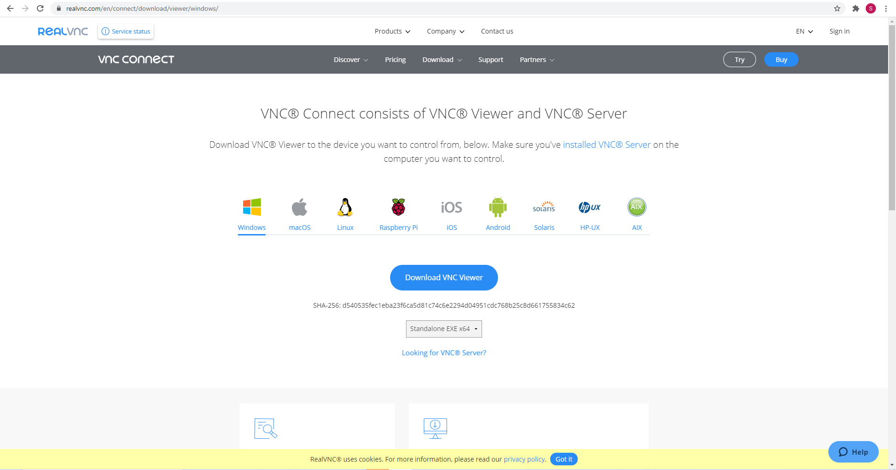
Step 9: Download VNC Viewer on the Laptop
WEBINAR

Slide 12
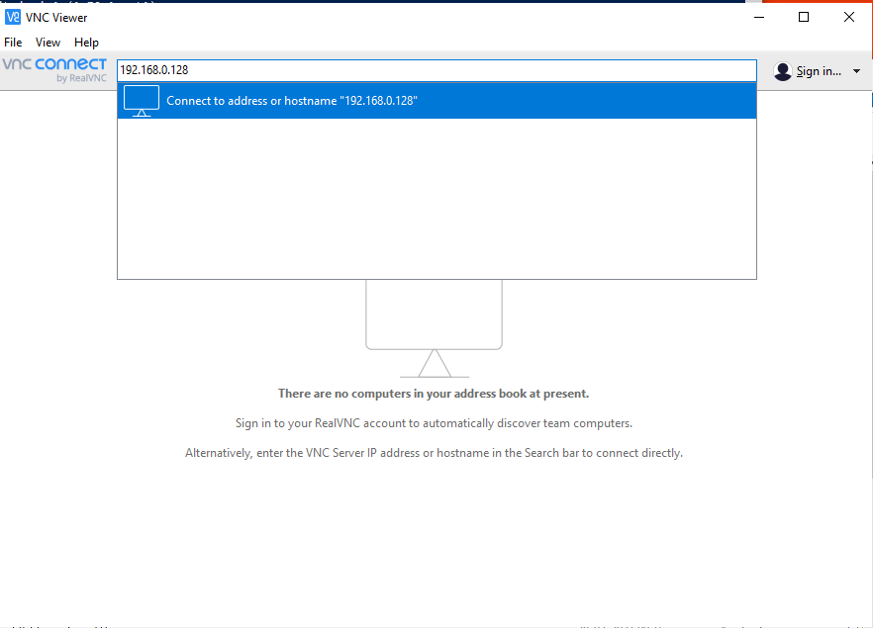
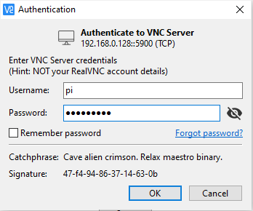
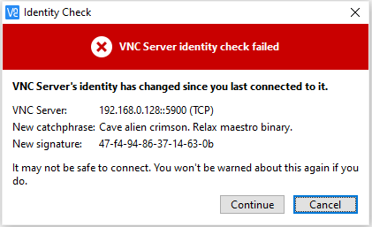
Step 10: Connect to the Raspberry Pi
WEBINAR

Slide 13

Step 10: Connect to the Raspberry Pi
WEBINAR

Slide 14
Step 11: Connect to the Raspberry Pi
WEBINAR

Slide 15
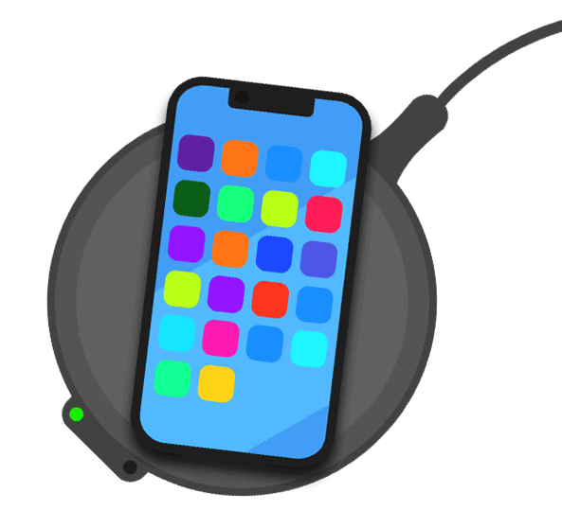
WEBINAR
Thank you
for coming!
-YoungWonks Team

